Slide 1
A Keyword Spotting Model

Slide 2


Collect
Data
Preprocess
Data
Design a
Model
Train a
Model
Evaluate
Optimize
Convert
Model
Deploy
Model
Make
Inferences
Micro
Notes:
We are now moving to designing a model!

Slide 3
Collect
Data
Preprocess
Data
Design a
Model
Train a
Model
Evaluate
Optimize
Convert
Model
Deploy
Model
Make
Inferences
Micro
Notes:
We are now moving to designing a model!

Slide 4
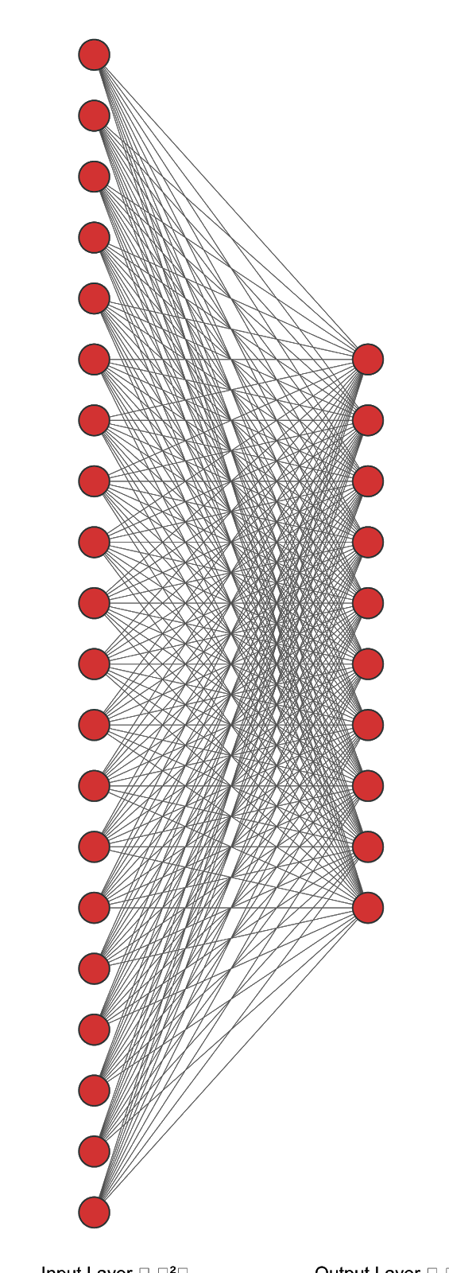
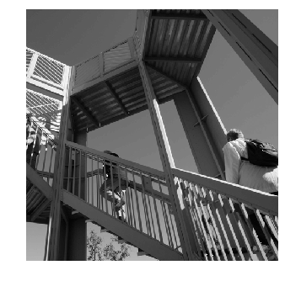
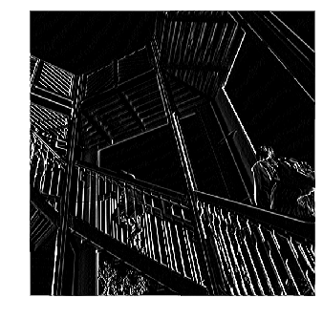
A model for Keyword Spotting
Classification
Convolution
Input Image
Output Class
Features
-1 | 0 | 1
-2 | 0 | 2
-1 | 0 | 1
Notes:
Remember from last course we had a CNN where we took an input image and put it through a series of filters via convolutions to get some features and classify those features to get our outputs
all from 2-3-2 (LAURENCE OWNED)

Slide 5
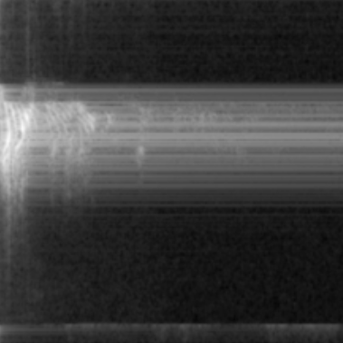
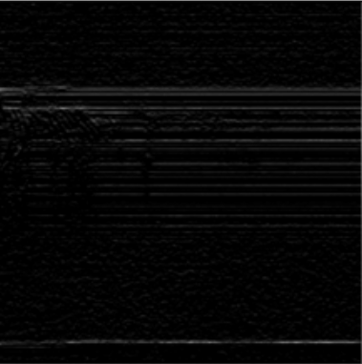
A model for Keyword Spotting
Classification
Convolution
Input Image
Output Class
Features
-1 | 0 | 1
-2 | 0 | 2
-1 | 0 | 1
Spectrograms are just an image so we can use this same pipeline!
Notes:
Remember from last course we had a CNN where we took an input image and put it through a series of filters via convolutions to get some features and classify those features to get our outputs
all from 2-3-2 (LAURENCE OWNED)

Slide 6
Can we use the same model we used in Course 1 for Horses v. Humans?
Notes:
Answer: no

Slide 7
model = tf.keras.models.Sequential([
# Five convolutional + pooling layers to extract features
tf.keras.layers.Conv2D(16, (3,3), activation='relu', input_shape=(300, 300, 3)),
tf.keras.layers.MaxPooling2D(2, 2),
tf.keras.layers.Conv2D(32, (3,3), activation='relu'),
tf.keras.layers.MaxPooling2D(2,2),
tf.keras.layers.Conv2D(64, (3,3), activation='relu'),
tf.keras.layers.MaxPooling2D(2,2),
tf.keras.layers.Conv2D(64, (3,3), activation='relu'),
tf.keras.layers.MaxPooling2D(2,2),
tf.keras.layers.Conv2D(64, (3,3), activation='relu'),
tf.keras.layers.MaxPooling2D(2,2),
# Flatten the results to feed into a DNN and classify
tf.keras.layers.Flatten(),
tf.keras.layers.Dense(512, activation='relu'),
tf.keras.layers.Dense(1, activation='sigmoid')
])
Notes:
Note that this is the model

Slide 8
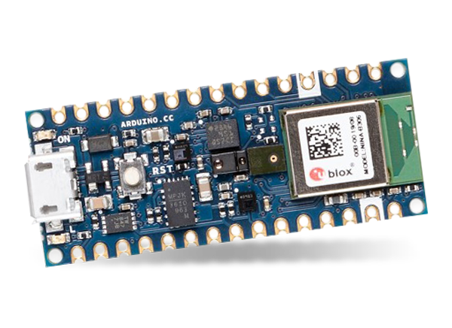
Our board [Course 3 Kit] only has 256KB of RAM (memory)
Notes:
Remind them of the constraint on memory which is so crucial for microcontrollers
BOARD: 1-3-4

Slide 9
# Convert the model to TFLite and print the size
tf.saved_model.save(model, SAVED_MODEL)
float_converter = tf.lite.TFLiteConverter.from_saved_model(SAVED_MODEL)
float_tflite_model = float_converter.convert()
float_tflite_model_size = open(FLOAT_MODEL_TFLITE,"wb").write(float_tflite_model)
print("Float model is %d bytes" % float_tflite_model_size)
Our board [Course 3 Kit] only has 256KB of RAM (memory)
Notes:
Ask them to think about how much memory will happen when we print the size of the tflite model using floats

Slide 10
# Convert the model to TFLite and print the size
tf.saved_model.save(model, SAVED_MODEL)
float_converter = tf.lite.TFLiteConverter.from_saved_model(SAVED_MODEL)
float_tflite_model = float_converter.convert()
float_tflite_model_size = open(FLOAT_MODEL_TFLITE,"wb").write(float_tflite_model)
print("Float model is %d bytes" % float_tflite_model_size)
6822684 bytes ~ 6,800 KB
Our board [Course 3 Kit] only has 256KB of RAM (memory)
Notes:
Ask them to think about how much memory will happen when we print the size of the tflite model using floats

Slide 11
# Quantize the model and print the size
converter = tf.lite.TFLiteConverter.from_saved_model(SAVED_MODEL)
converter.optimizations = [tf.lite.Optimize.DEFAULT] # INT8 Quantization
converter.representative_dataset = representative_data_gen # extract test dataset
tflite_model = converter.convert()
tflite_model_size = open(MODEL_TFLITE, "wb").write(tflite_model)
print("Quantized model is %d bytes" % tflite_model_size)
Our board [Course 3 Kit] only has 256KB of RAM (memory)
Notes:
Ask them to think about how much memory will happen when we print the size of the tflite model using floats

Slide 12
# Quantize the model and print the size
converter = tf.lite.TFLiteConverter.from_saved_model(SAVED_MODEL)
converter.optimizations = [tf.lite.Optimize.DEFAULT] # INT8 Quantization
converter.representative_dataset = representative_data_gen # extract test dataset
tflite_model = converter.convert()
tflite_model_size = open(MODEL_TFLITE, "wb").write(tflite_model)
print("Quantized model is %d bytes" % tflite_model_size)
1722272 bytes ~ 1,700 KB
Our board [Course 3 Kit] only has 256KB of RAM (memory)
Notes:
Ask them to think about how much memory will happen when we print the size of the tflite model using floats

Slide 13
# Quantize the model and print the size
converter = tf.lite.TFLiteConverter.from_saved_model(SAVED_MODEL)
converter.optimizations = [tf.lite.Optimize.DEFAULT] # INT8 Quantization
converter.representative_dataset = representative_data_gen # extract test dataset
tflite_model = converter.convert()
tflite_model_size = open(MODEL_TFLITE, "wb").write(tflite_model)
print("Quantized model is %d bytes" % tflite_model_size)
NEED SMALLER MODEL
Our board [Course 3 Kit] only has 256KB of RAM (memory)
Notes:
Ask them to think about how much memory will happen when we print the size of the tflite model using floats

Slide 14
TinyConv Model

Slide 15
tiny_conv model
One Conv2D followed by a single Dense Layer!
Our board [Course 3 Kit] only has 256KB of RAM (memory)
Notes:
TINYML is very specific and that’s where it is good vs. general in the cloud (tie back to the federated model)

Slide 16
tiny_conv model
Input Data
Reshape
Softmax
Output Classification
Weights: <1,10,8,8>
Bias: <8>
DepthwiseConv2D
Weights: <4,4000>
Bias: <4>
FullyConnected
Our board [Course 3 Kit] only has 256KB of RAM (memory)
Notes:
TINYML is very specific and that’s where it is good vs. general in the cloud (tie back to the federated model)

Slide 17
tiny_conv model
10 x 8 x 8 + 8 = 648 parameters
4 x 4000 + 4 = 16,004 parameters
16,652
parameters
Input Data
Reshape
Softmax
Output Classification
Weights: <1,10,8,8>
Bias: <8>
DepthwiseConv2D
Weights: <4,4000>
Bias: <4>
FullyConnected
Our board [Course 3 Kit] only has 256KB of RAM (memory)
Notes:
TINYML is very specific and that’s where it is good vs. general in the cloud (tie back to the federated model)

Slide 18
tiny_conv model
10 x 8 x 8 + 8 = 648 parameters
4 x 4000 + 4 = 16,004 parameters
16,652
parameters
Input Data
Reshape
Softmax
Output Classification
Weights: <1,10,8,8>
Bias: <8>
DepthwiseConv2D
Weights: <4,4000>
Bias: <4>
FullyConnected
For floats that’s <70Kb
Quantized that’s <17Kb
Our board [Course 3 Kit] only has 256KB of RAM (memory)
Notes:
TINYML is very specific and that’s where it is good vs. general in the cloud (tie back to the federated model)

Slide 19
tiny_conv model
One Conv2D followed by a single Dense Layer!
<70 KBs for float and only <17 KBs quantized
Our board [Course 3 Kit] only has 256KB of RAM (memory)
Notes:
TINYML is very specific and that’s where it is good vs. general in the cloud (tie back to the federated model)

Slide 20
tiny_conv model
One Conv2D followed by a single Dense Layer!
FAST INFERENCE
<70 KBs for float and only <17 KBs quantized
Our board [Course 3 Kit] only has 256KB of RAM (memory)
Notes:
TINYML is very specific and that’s where it is good vs. general in the cloud (tie back to the federated model)

Slide 21
Notes:
Remember we are trying to solve a very specific problem here. Just to wake up on the keywords. Therefore we can get away with a model that is smaller and less powerful! This is why we use this as part of a federated application and use a much larger general speech model in the cloud to figure out a users specific query! This is another example of how TinyML is different than standard ML. Here we are solving very specific problems with very specific datasets and models!

Slide 22
A model for Keyword Spotting
Classification
Convolution
Input Image
Output Class
Features
-1 | 0 | 1
-2 | 0 | 2
-1 | 0 | 1
Spectrograms are just an image so we can use this same pipeline!

Slide 23
model = tf.keras.models.Sequential([
# Five convolutional + pooling layers to extract features
tf.keras.layers.Conv2D(16, (3,3), activation='relu', input_shape=(300, 300, 3)),
tf.keras.layers.MaxPooling2D(2, 2),
tf.keras.layers.Conv2D(32, (3,3), activation='relu'),
tf.keras.layers.MaxPooling2D(2,2),
tf.keras.layers.Conv2D(64, (3,3), activation='relu'),
tf.keras.layers.MaxPooling2D(2,2),
tf.keras.layers.Conv2D(64, (3,3), activation='relu'),
tf.keras.layers.MaxPooling2D(2,2),
tf.keras.layers.Conv2D(64, (3,3), activation='relu'),
tf.keras.layers.MaxPooling2D(2,2),
# Flatten the results to feed into a DNN and classify
tf.keras.layers.Flatten(),
tf.keras.layers.Dense(512, activation='relu'),
tf.keras.layers.Dense(1, activation='sigmoid')
])
Notes:
Note that this is the model

Slide 24
tiny_conv model
10 x 8 x 8 + 8 = 648 parameters
4 x 4000 + 4 = 16,004 parameters
16,652
parameters
Input Data
Reshape
Softmax
Output Classification
Weights: <1,10,8,8>
Bias: <8>
DepthwiseConv2D
Weights: <4,4000>
Bias: <4>
FullyConnected
Our board [Course 3 Kit] only has 256KB of RAM (memory)
Notes:
TINYML is very specific and that’s where it is good vs. general in the cloud (tie back to the federated model)

Slide 25
tiny_conv model
10 x 8 x 8 + 8 = 648 parameters
4 x 4000 + 4 = 16,004 parameters
16,652
parameters
Input Data
Reshape
Softmax
Output Classification
Weights: <1,10,8,8>
Bias: <8>
DepthwiseConv2D
Weights: <4,4000>
Bias: <4>
FullyConnected
For floats that’s <70Kb
Quantized that’s <17Kb
Our board [Course 3 Kit] only has 256KB of RAM (memory)
Notes:
TINYML is very specific and that’s where it is good vs. general in the cloud (tie back to the federated model)

Slide 26
tiny_conv model
One Conv2D followed by a single Dense Layer!
<70 KBs for float and only <17 KBs quantized
Our board [Course 3 Kit] only has 256KB of RAM (memory)
Notes:
TINYML is very specific and that’s where it is good vs. general in the cloud (tie back to the federated model)

Slide 27
tiny_conv model
Fast Inference!
One Conv2D followed by a single Dense Layer!
<70 KBs for float and only <17 KBs quantized
Our board [Course 3 Kit] only has 256KB of RAM (memory)
Notes:
TINYML is very specific and that’s where it is good vs. general in the cloud (tie back to the federated model)

